Slide 1
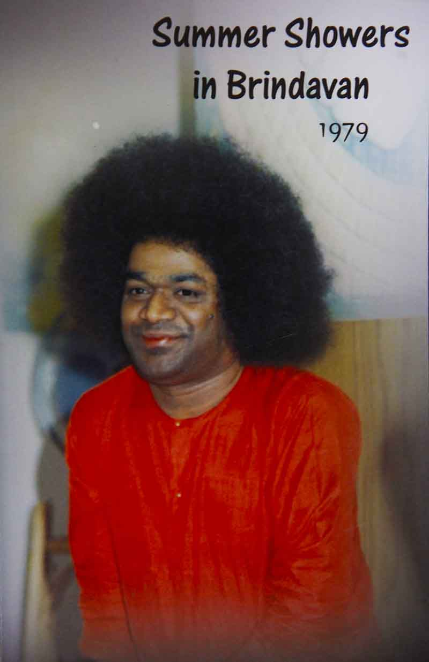
Karma Yoga
Chapter 13 in SSB 1979

Slide 2
Rights of Man
Man has but the right to perform action; to ask for the fruits thereof he has none.
God alone can dispense the fruits of man’s actions

Slide 3

Sleep over it!
Embodiments of the Divine Atma!
Everyday from morning till night you spend your life in merely earning the means of your livelihood. What great happiness have you attained by employing your skill and education in only filling your stomach, forgetting the Lotus-eyed Lord?
O, man! Ponder over this with deep regard.

Slide 4
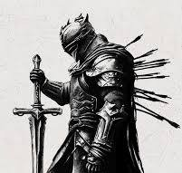
Whether you like it or not
Sacrifice (tyaga) is the essence of spiritual life. All men must necessarily have tyaga. Although one may not be willing to make sacrifices, nature shall force him to do so. It behoves man, therefore, to undertake sacrifice even before he is so compelled.

Slide 5
External Sacrifice
Lord Krishna stresses in the Bhagavad Gita that absolute purity of the heart is an essential requisite for treading the path of sacrifice.
What is sacrifice?
What is it that one must give up?
Is it the transient wealth one has?
Does sacrifice mean the giving up of one’s wife and children?
Nay, these are but matters that relate to the environment conditioning man’s external life.

Slide 6
True Sacrifice
Sacrifice means giving up one’s desires (kama), anger (krodha) and greed or extreme miserliness (lobha).
Man generally identifies himself with the anatma (non-Atma) without realising his true nature. The reflection of the sky in a pot of water disappears the moment you pour out the water. Likewise, when you recognise the temporal nature of all that is non-Atma and attribute their ephemeral existence to worldly desires (water) and give them up, you get closer to the Atma. Unless you sacrifice desire, anger and greed or miserliness, you cannot attain Divinity.

Slide 7

Desire vs. Duty
Desire impels you to go against the established code of social behaviour even at the cost of losing your honour and reputation. It makes you get immersed in selfishness and disregard your duty to society and God.
It raises its ugly hood in every aspect of your life and turns you into a demon.

Slide 8
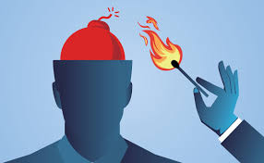
Anger-ruins
Anger destroys your intelligence and warps your judgement. The angry man forfeits success in all his endeavours and invites societal censure. He brings dishonour to himself, to his friends and relations desert him. He is led to sin and thereby ruins his life.

Slide 9
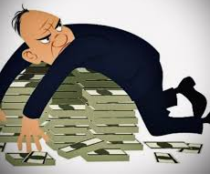
Greed stems from fear
Lobha or extreme miserliness does not let anyone be happy. A miser neither enjoys himself nor allows others to utilise his wealth. For everything he takes a retrogressive step, fearing loss of his property or diminution in his wealth.

Slide 10
Miser and Greater Miser
There is a small story to illustrate this. There were two brothers by names Miser and Greater Miser. True to their names, they were so niggardly that they did not even feed themselves properly. On occasions, when they prayed to God to further their worldly interests, they would not even proffer naivedya, (sacred offering to God). They would merely let Him have a cursory glance at it and eat it up themselves within moments.

Slide 11
Heights of Miserliness
The reason for this great hurry, in not allowing the offering to remain at the altar for more than a few seconds was the fear that if the sugar candy offered as naivedya was kept any longer, some ants might partake of it in small quantities and thereby deprive them of valuable granules of precious sugar!

Slide 12
One day, news came that one of their near relations had died. The elder brother, Greater Miser, decided to offer condolences to the bereaved family in person, and therefore set out early next morning by foot. He did not start immediately on the same day by bus or train, as travel by these means of transport would entail an insufferable burden by way of travel fares!

Slide 13
After his elder brother had gone, Miser put out the lamp and placed it on a windowsill, only to be stung by a vicious scorpion. While the younger brother was suffering thus, Greater Miser had put some two miles behind him. Suddenly, he became thoughtful and hastened back to the house. On being asked by Miser the reason for his unscheduled return, Greater Miser replied, “O, brother! I was worried that you may not have put out the lamp after I left. I have, therefore, come back to remind you.”

Slide 14
To this, Miser in spite of his excruciating pain, said ruefully “Alas! brother, your desire to avoid wastage of oil is indeed appreciable, but what a pity, how much your sandals would have worn out by this unnecessary return of yours!”

Slide 15
Greater Miser then replied, “My dear Miser, do not worry. I walked barefoot with my sandals in my hands.”
Such is the bane wrought by lobha.

Slide 16
Therefore, Krishna enjoined Arjuna to be free from these vices, overcome illusion, develop inner vision and spiritual wisdom, and follow the path of karma sanyasi yoga (the renunciation of the fruits of one’s actions).
In karma sanyasa yoga, we have three words, karma, sanyasa, and yoga. Karma means action; sanyasa means renunciation of worldly taints (vasanas) and desires, and rising above attachment and hatred; and yoga means union with the Divine.

Slide 17
“O, Arjuna,” Krishna said, “this aspect of sanyasa is lacking in you. You are still swayed by attachment and ego.” None can desist from action. Man is continually engaged in action. Therefore, renunciation of action (karma sanyasa) is neither realistic nor practical.
“Instead, while performing action, transform it into worship. Dedicate all your actions to God and perform them for His pleasure. Such actions will place you on the path of bhakthi (devotion).”

Slide 18
Once, a sage brought three dolls to the court of a king and asked for the best doll to be identified. A clever minister passed a thin wire through one ear of each of the dolls. The wire came out of the other ear in the case of the first doll and through the mouth in the case of the second. In the case of the third doll, however, the wire went deep inside.

Slide 19
Explaining the significance, the minister held that the third doll was the best. It represented the man who understood and retained the true meaning of whatever he heard and put it into practice. The second doll stood for the mere prattler who did not put anything he heard into actual practice, while the first signified the worst among men—he who simply let what he heard through one ear out from the other.

Slide 20
Message for the students
Students should listen to the sacred message of the Gita and imbibe it in their hearts. Recognising the truth that motiveless action performed for the pleasure of God (karma yoga) is higher than giving up of all activity, they should serve society in a selfless manner without an eye for reward. Develop love for all so that greed does not seize you into a state of godlessness. Also desire and anger should be controlled to the maximum possible extent

